Slide 4
The most basic figures in geometry are undefined terms, which cannot be defined by using other figures. The undefined terms point, line, and plane are the building blocks of geometry.

Slide 5
Point, Line and Plane.
Point: a point names a location and is represented by a dot.
Has no thickness
Line: a line is a straight path.
Has no thickness and extends forever.
Plane: a plane is a flat surface.
Has no thickness and extends forever.

Slide 7
Points that lie on the same line are collinear. K, L, and M are collinear. K, L, and N are noncollinear. Points that lie on the same plane are coplanar. Otherwise they are noncoplanar.
K
L
M
N

Slide 9
Opposite Rays
This one always seems to be an issue with students.
You need to think about two rays (two arrows) that point in exact opposite directions but also share the point they start at.
C A B

Slide 11
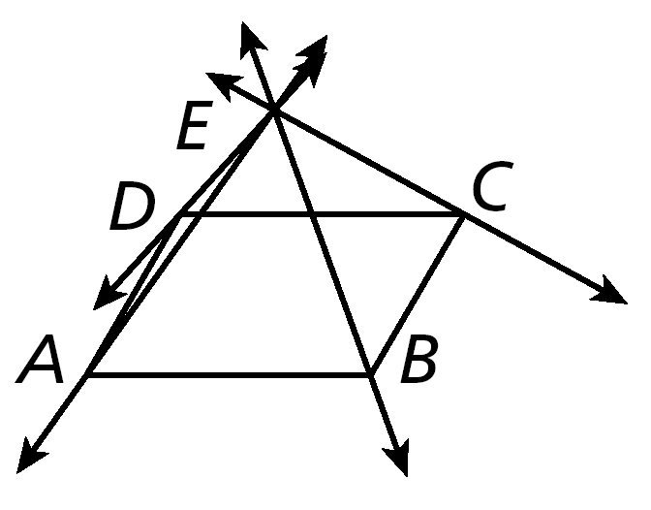
Examples
1) Name the following. 2) Draw and label each of the following.
A. a segment with endpoints M and N.
B. opposite rays with a common endpoint T.
A. Name four coplanar points.
B. Name three lines.

Slide 12
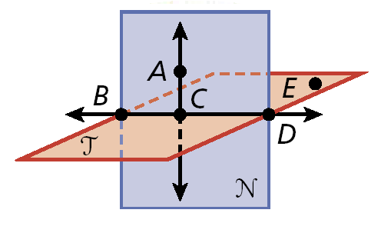
3) Name the following.
A. Two opposite rays.
B. A point on BC.
C. The intersection of plane N and plane T.
D. A plane containing E, D, and B.

Slide 13
Classwork/Homework
Page 9, #’s 13-27

Slide 14
Section 1.6 p216
1, 3, 21, 29, 37, 39, 47, 49, 53, 57, 61, 65

